Slide 1
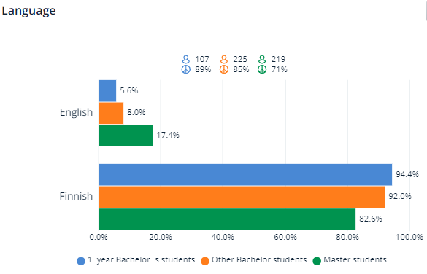
Background information
No compulsory questions, respondents have not necessarily answered all questions
564 answers
Select the correct alternative. I am | Answers | %
1. year Bachelor's degree student | 107 | 19,4%
2. year Bachelor's degree student | 113 | 20,5 %
3. or a higher year Bachelor's degree student | 112 | 20,3 %
1. year Master's degree student | 148 | 26,9 %
2. or a higher year Master's degree student | 71 | 12,9 %

Slide 2
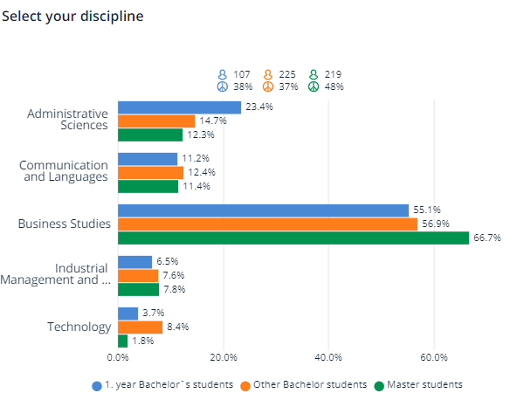
Background information
 | 1.Year Bachelor´s students | Other Bachelor students | Master students
Administrative Sciences | 25 | 33 | 27
Communication and Languages | 12 | 28 | 25
Business Studies | 59 | 128 | 146
Industrial Management and Information Systems | 7 | 17 | 17
Technology | 4 | 19 | 4

Slide 3
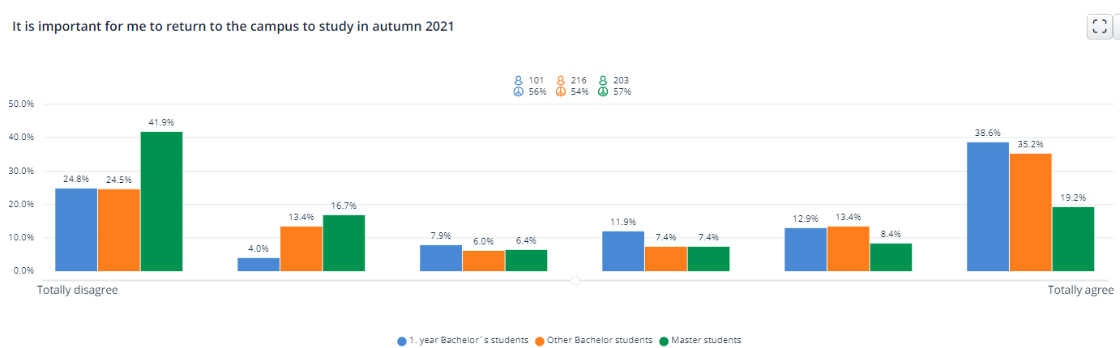
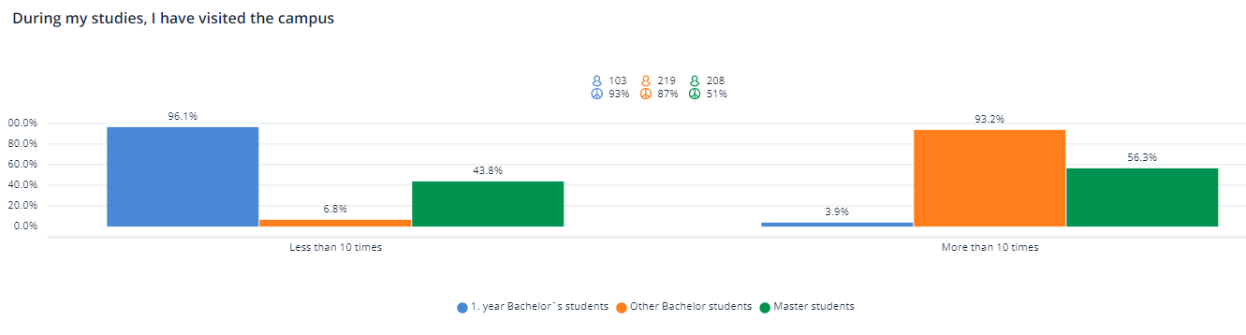

Slide 4
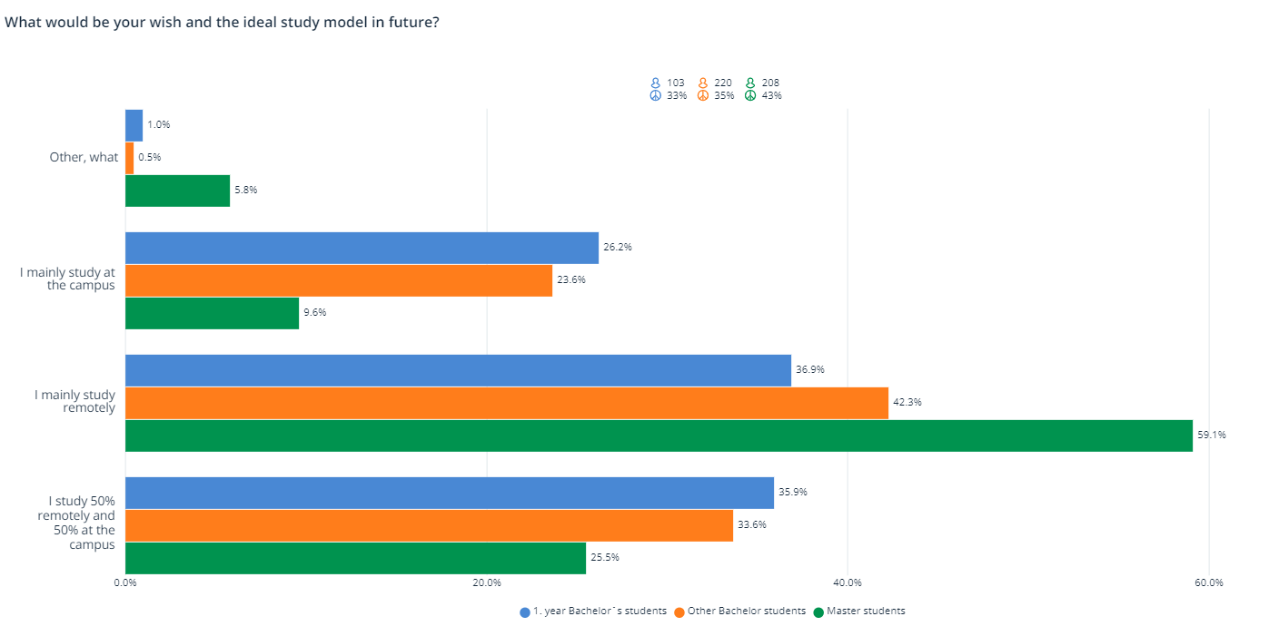
Other, what?
Hybrid study, where the student can choose the time and place for their study.
Several Master’s degree students are hoping for the opportunity to complete their studies entirely remotely to completion.

Slide 5

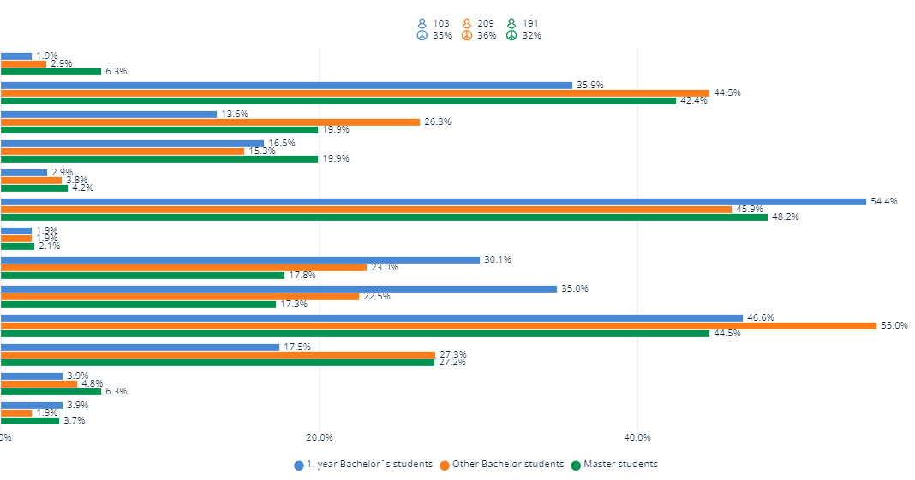
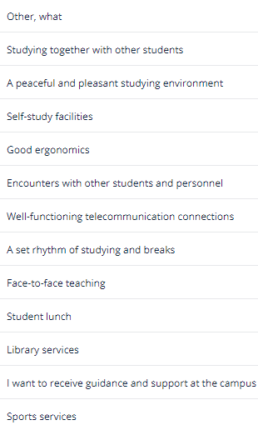

Slide 6

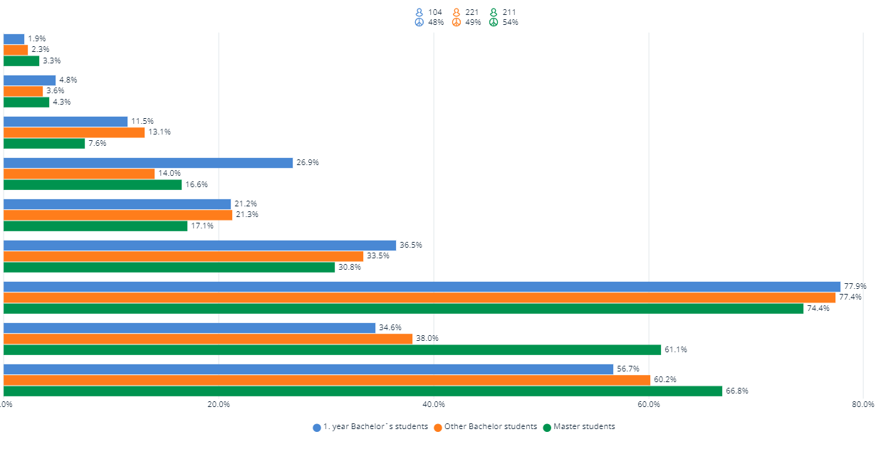
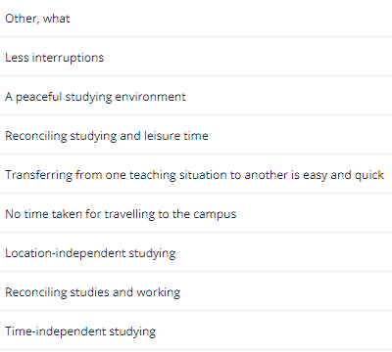
Other, what?
Reconciling family life and studies
Possibility to live outside Vaasa
Recorded lectures

Slide 7
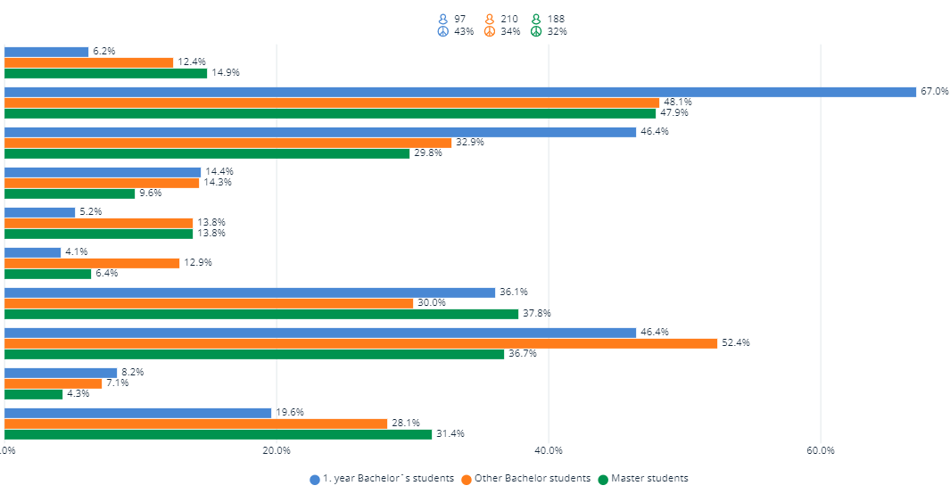
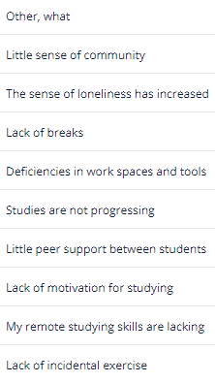
Other, what?
Workload and requirements for some courses higher than usual
Separating study and leisure is challenging
Some have not experienced any challenges in distance learning

Slide 8
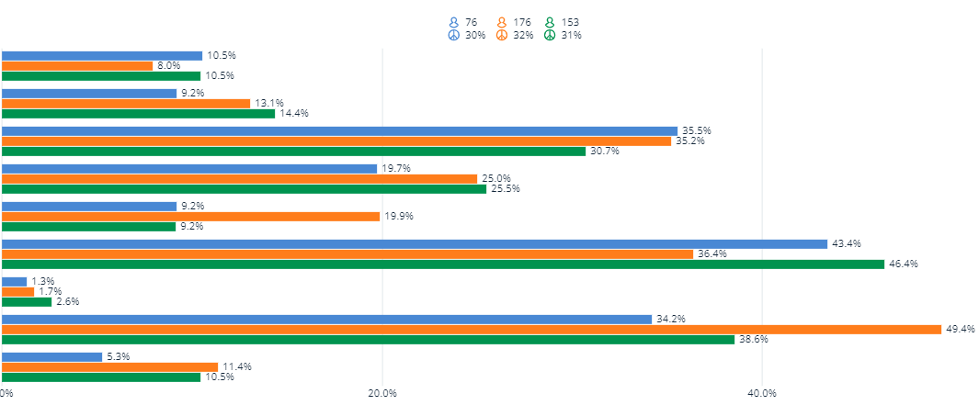
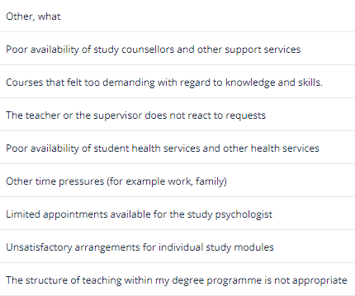
Other, what?
Too demanding courses and overlapping course implementations
Incomplete / poor communication on courses
Networking and community is challenging
Oma terveydentila, motivaation puute ja yksinäisyys

Slide 9

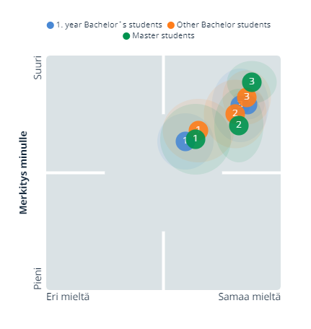
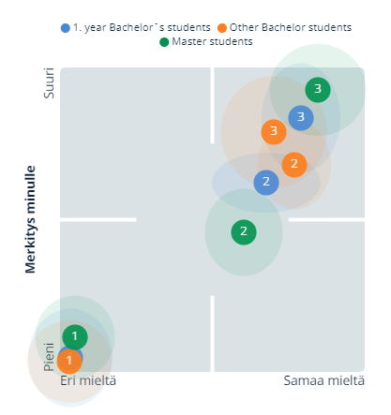
What do you think about the following issues?
Normalized result
By using the ZEF method, the person who analyzes the results can make
better data based decisions, because the respondents’ opinion distortions are automatically removed, or normalized. This makes the results
easier to understand and interpret. In addition to this, ZEF reports show
the organization’s strengths and weaknesses more clearly than a raw
report.

Slide 10
Summary of open questions

Slide 11
In your opinion, which factors should be paid particular attention to when developing teaching and study guidance?
First year Bachelor students
Other Bachelor students
In the future, students hope that there will be more flexibility in studies and that the possibility of distance learning will continue alongside contact teaching. Students also hope that the distance exam opportunity will continue.
Recording lectures and watching them afterwards is seen as supporting individual learning and the pace of study.
Students hope that attention will be paid to ensuring that the number of credits and assignments in the courses is even and that the structure of the courses is uniform.
In addition, students want clarity in course selection processes and course descriptions. The importance of continuous, timely and accurate information was emphasized. Issues related to scheduling need to be improved.
In the future, students hope multi-location and time-flexible learning, as it allows for a better reconciliation of study and work (or other life).
Students see the importance of taking into account different needs and life situations when organizing teaching.
According to the students, the level of difficulty of distance learning has increased significantly compared to contact studies. Distance learning is currently perceived as too demanding and laborious. Students want more diverse course implementations.
There is also a need for contact studies and it is hoped that the university will have various facilities where you can e.g. listen to a remote lecture and, if necessary, also take part in the discussion.

Slide 12
In your opinion, which factors should be paid particular attention to when developing teaching and study guidance?
Master students
Most master’s students want flexibility and the opportunity to complete their master’s studies entirely remotely. Many students are already in working life and distance learning makes it possible to combine work and study seamlessly.
Based on the students’ responses, the recorded lectures support the progress of the studies.
Attention should be paid to the planning of studies. Students also hope that the courses will be more evenly distributed over the academic year.
If opportunities for flexible learning are offered in the future, how will equality and non-discrimination be taken into account?

Slide 13
What do you expect from the University of Vaasa when returning to the campus?
First year Bachelor students
Other Bachelor students
Students expect good togetherness, new friends, shared lunches, interactions and joint events.
In addition, students hope to study together, flexibility in their studies, a safe return to campus, and low-threshold contacts with teachers.
Most first-year students have not participated in contact teaching at the university. It is hoped that this issue will be taken into account in the autumn.
First year bachelor students wish a campus presentation, as most have not even visited the campus of the University of Vaasa.
Other bachelor students expect flexible distance learning opportunities to continue. Students hope that different life situations are taken into account and e.g. the fact that some no longer live in Vaasa.
Students see daily encounters on campus, peer support, and community as important resources.
Café and restaurant services as well as a library are expected to open. In addition, comfortable (self) study spaces and pleasant learning environments are desired.
Hygiene and safety must also be taken seriously. However, students hope for predictability by not closing the entire campus because of a single infection.

Slide 14
What do you expect from the University of Vaasa when returning to the campus?
Master students
Students hope that distance learning will continue and that there will be flexibility in studies. Some students hope there is no need to return to campus at all.
Some master’s students see community and the opportunity to meet other students on campus as very important. They hope that the University of Vaasa will strive to provide this opportunity as soon as it is safely possible.
Students look forward to the opening of the library and self-study facilities, as well as student lunches. In addition to these, students expect peer support for their studies and study together.

Slide 15
Summary of responses
For the future, it is important to provide opportunities for flexible study. From the students' point of view, hybrid studying mean that the student can choose whether to complete the course remotely or in contact teaching. How about attending the lecture on your mobile phone or even from the Campus café? The importance of time -and location-independent studying was emphasized in the responses.
Several Master’s degree students wish the opportunity to complete their studies entirely remotely. Distance learning makes it possible to reconcile work, study and also family life.
The campus is seen as a common meeting place for students and staff. Studying together and sharing lunch moments are perceived as important resources. Students also expect the library and self-study facilities to open.
The answers show that the decrease in community spirit and peer support between students in studies increases loneliness and weakens study motivation.
According to the students' feedback, the workload of the courses completed at a distance has been higher than the contact teaching of the same course. In addition, courses should be distributed more evenly over the semester and attention should be paid to the workload of individual courses in relation to credits.
Recording lectures and watching them afterwards is seen as supporting individual learning and the pace of study.
In summary, students hope diverse, flexible and alternative course implementations.

